Slide 1
Operating System: Overview
Operating Systems & Computer Architecture
CT049-3-1-OS&CA
Ver: VC1

Slide 2
Topics we will cover
The OS Concept
Services and Facilities of the OS
  UIs and Command Execution Services
  File Management
  I/O Services
  Network Communications Support Services
  Security Protection Services
  System Administration Support
Organization of OS
OS Types

Slide 3
Learning Outcomes
At the end of this section, YOU should be able to:
Define an Operating System
Explain how an Operating System functions and its requirements

Slide 4
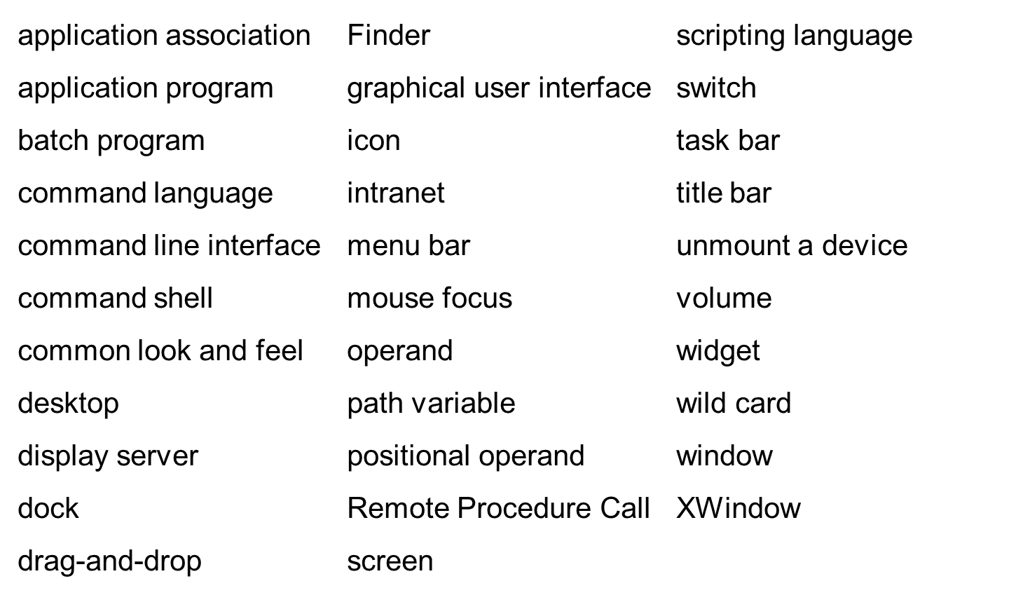
Key Terms

Slide 5
Without an Operating System…
Program instructions must be loaded into memory by hand
No user interface except for I/O routines provided with executing program
System is idle when waiting for user input
No facility to store, retrieve, or manipulate files
No ability to control peripheral devices
Can run only one program at a time; computer halts at end of each program

Slide 6
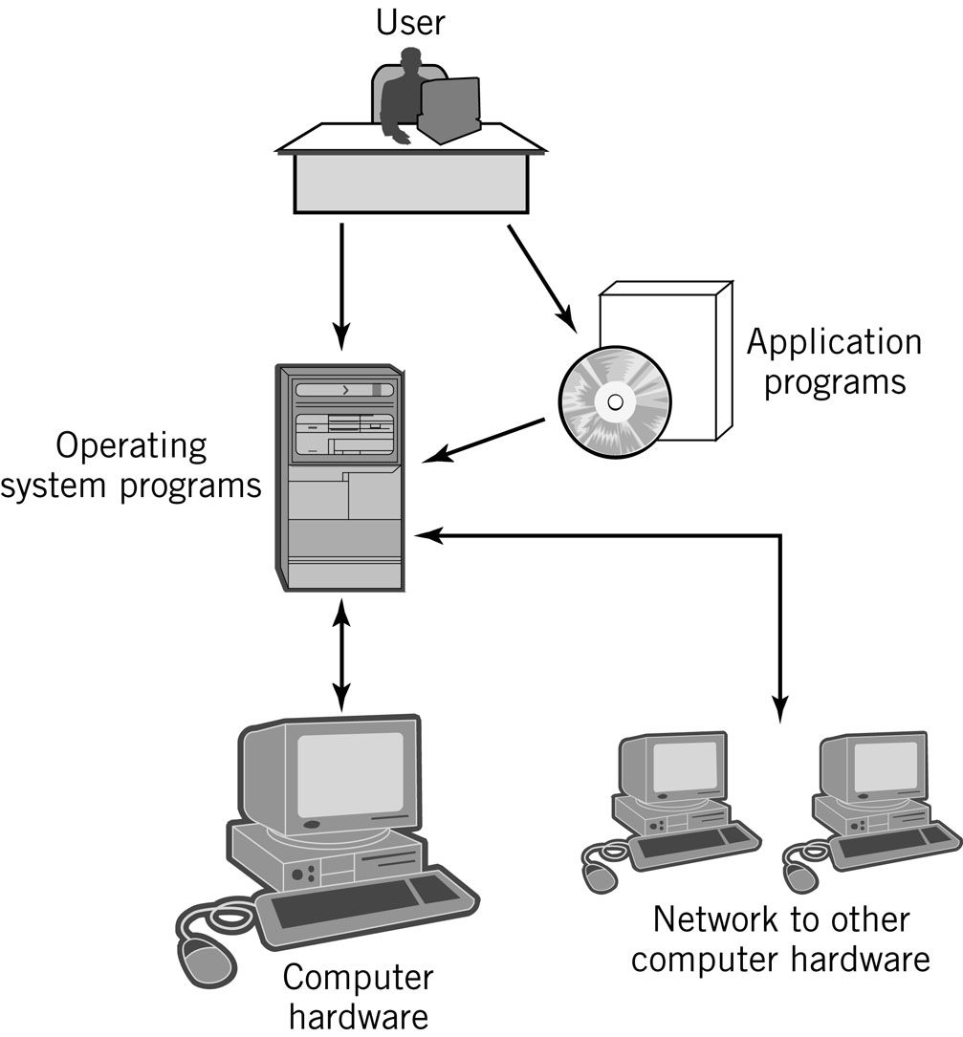
Integrated Computer Environment

Slide 7
Definition of an Operating System
“A collection of computer programs that integrate the hardware resources of the computer and make those resources available to a user and the user’s programs, in a way that allows the user access to the computer in a productive, timely, and efficient manner.”

Slide 8
Operating System – Basic Services
Accepts commands and requests from users and users’ programs and responds with appropriate output results
Manages, loads, and executes programs
Manages hardware resources of the computer including interfaces to networks and other external parts of the system
Note: The operating system itself consists of hundreds or thousands of programs, each specialized for particular OS tasks.

Slide 9
Concurrent Operations
Multitasking (multiprogramming)
  Use of concurrent processing to simulate simultaneous execution of multiple programs even when using only a single CPU
  Supports multiuser systems
Multiprocessing
  Actual simultaneous processing of multiple programs using either multiple CPUs or multiple CPU cores

Slide 10
Operating System – Additional Services
Provides interfaces for the user and the user’s programs
File management and support services
I/O support services
Means of starting the computer
  Bootstrapping or booting the computer or Initial Program Load (IPL)
Handles all interrupt processing
Network services
Services to allocate resources such as memory, CPU time, and I/O devices
Security and protection services
Systems administration

Slide 11
Operating System Components
Memory Resident
  Always loaded in memory
  Commonly called the kernel
  Contains essential services required by other parts of the operating system and applications.
  Typically responsible for managing memory management, processes and tasks, and secondary storage
Memory Non-resident
  Infrequently used programs
  Software tools
  Commands
Bootstrap program

Slide 12
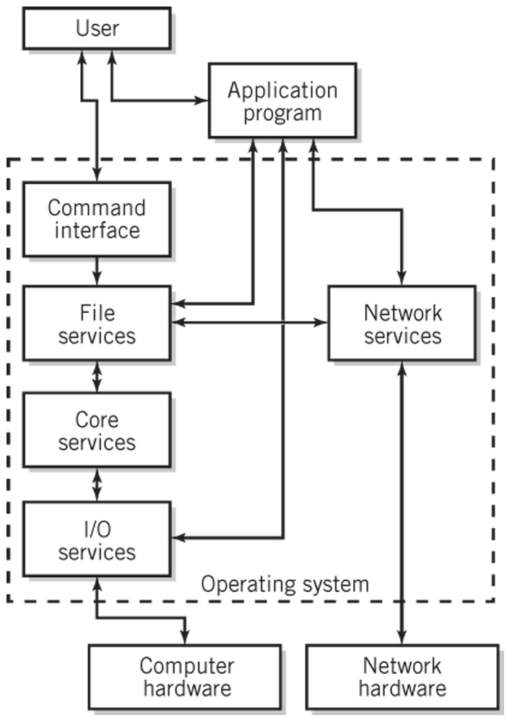
Simplified Diagram of Operating
System Services

Slide 13
General Purpose Computing
Systems Categories
Single-user, single tasking (essentially obsolete)
Single-user, multitasking
Mainframes
Network servers
Distributed systems
Real-time systems
Operating systems for mobile devices
Embedded systems

Slide 14
OS Degree of Activity
Interactive
  Also known as conversational systems
Batch processing
  User submits programs or jobs for processing
  Little to no user interaction
Event driven
  Interrupts or service requests

Slide 15
Hardware and the OS
A hardware platform may support a variety of operating systems
An operating system may work on a variety of platforms
A standard operating system that works on different hardware
  Provides program and file portability
  Enables user efficiency through recognizable interface
  Is implemented through a systems programming language like C++ or Java as opposed to assembly language

Slide 16
Services and Facilities
Command processor
File management system
I/O control system
Process control management and interprocess communication
Memory management
Scheduling system
Secondary storage management
Network management, communication support, and communication interfaces
System protection management and security
System administration

Slide 17
User Interface and
Command Execution Services
Types of user interfaces
  CLI - Command Line Interface
  GUI - Graphical User Interface
Shell
  User interface and command processor that interacts with the kernel
  UNIX/Linux: C, Bourne, bash and Korn shells
Command Languages
  IBM Mainframes – JCL
  MS Windows – .BAT files, Windows Powershell
  UNIX/Linux – shell scripts

Slide 18
File Management
File - logical unit of storage
Basic file management system provides
  Directory structures for each I/O device
  Tools to copy, move, store, retrieve and manipulate files
  Information about each file in the system and the tools to access that information
  Security mechanisms to protects files and control access
Additional file management features
  Backup, emergency retrieval and recovery
  File compression
  Journaling
  Transparent network file access
  Auditing

Slide 19
I/O Services
Startup configuration
  IBM-type PCs use BIOS (basic input/output system)
Device drives that implement interrupts and provide other techniques for handling I/O
Plug and play

Slide 20
Process Control Management
A process is an executing program
Inter-process messaging services
  Example: a pipe in UNIX or Windows that is a temporary software connection between two programs or commands
Thread
  An individually executable part of a process
  Shares memory and other resources with other threads of the same process

Slide 21
Memory Management
Keeps track of memory
  Identifies programs loaded into memory
  Amount of space each program uses
  Available remaining space
  Prevents programs from reading and writing memory outside of their allocated space
Maintains queues of waiting programs
Allocates memory to programs to be loaded
Deallocates a program’s memory space upon program completion
Usually implemented with virtual storage

Slide 22
Scheduling
High-level scheduling
  Placed in queue based on level of priority and eventually executed
Dispatching
  Actual selection of process(es) that will be executed at any given time
  Nonpreemptive: program voluntarily gives up control
  Preemptive: uses clock interrupt for multitasking
Context switching
  Transfer control to the process that is being dispatched
Processing requirements: CPU vs. I/O bound

Slide 23
Achieving Multitasking
While one program is waiting for I/O to take place, another program is using the CPU to execute instructions.
Time-slicing
  The CPU may be switched rapidly back and forth between different programs
Dispatcher
  is activated by I/O operation or real time clock interrupt
  selects next process to run

Slide 24
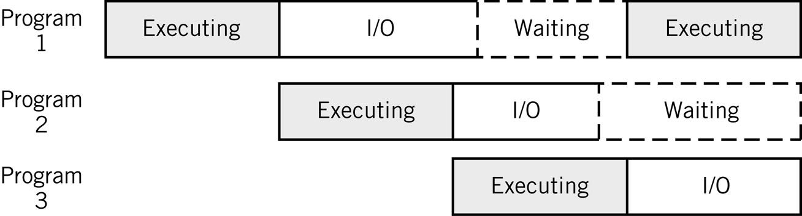
Sharing the CPU during I/O Breaks
I/O represents a large percentage of a typical program’s execution

Slide 25
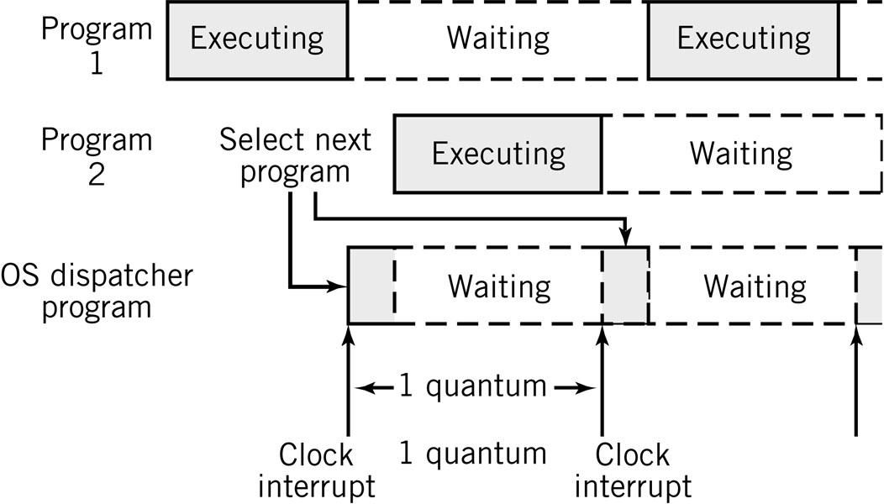
Time-sharing the CPU
Time slicing

Slide 26
Secondary Storage and Security
Secondary storage management
  Optimizes completion of I/O tasks for efficient disk usage
  Combination of hardware and software
Security and protection services
  Protect OS from users
  Protect users from other users
  Prevent unauthorized entry to system
  Prevent unauthorized system use by authorized users

Slide 27
Network and Communication Services
TCP-IP protocol suite
  Locate and connect to other computers
  Pass application data in packets to other systems
  Access files, I/O devices, and programs from remote systems
  Support distributed processing
Network Applications
  Email, remote login, Web services, streaming multimedia, voice over IP telephony, VPN
Communication services
  Interface between communication software and OS I/O control system that provides network access

Slide 28
System Administration Support
Network administration
Backups
Software installations and upgrades
OS installations (system generation), patches, and upgrades
System tuning and optimization
Monitoring performance
Recovering lost data
System configuration and setting group configuration policies
Adding and deleting users
Controlling and modifying user privileges
System security
Files systems management

Slide 29
Systems Tools Examples
IBM z/OS
  sysgen: reconfiguration to incorporate new equipment
  Workload Manager: optimize system resources automatically
Unix/Linux
  superuser: system administrator account with privileges to override all restrictions and security built into the system
  adduser: administer user accounts
  mount/umount: mount and unmount a file system
  fsck: check and repair a file system
  ufsdump/ufsrestore: create and restore backups
Windows
  Control panel
  Task manager (Ctrl-Alt-Del menu)

Slide 30
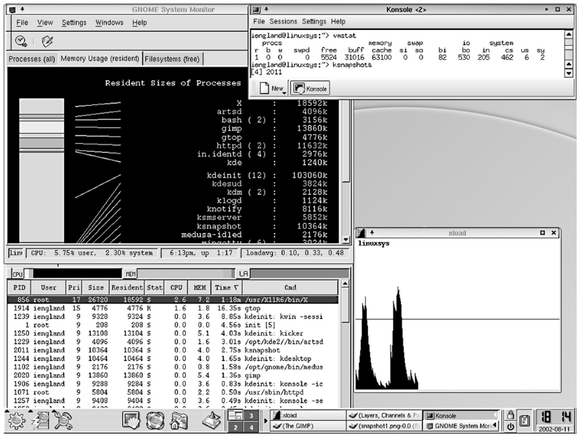
Typical System Status Report

Slide 31
OS Configurations
Three main configurations for the organization of an operating system
  Monolithic configuration
    Unix/Linux
  Hierarchical (layered) configuration
    Multics
    Windows 2000 and later versions (approximately hierarchical)
  Microkernel
    Macintosh OS X

Slide 32
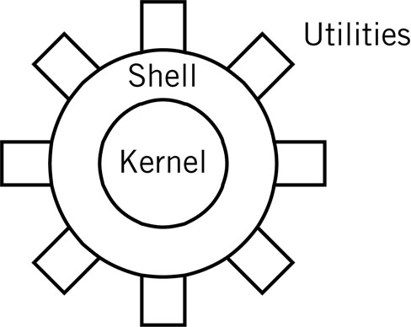
Monolithic Kernel
Drawback: stability and integrity must be managed carefully
Examples: UNIX, Linux

Slide 33
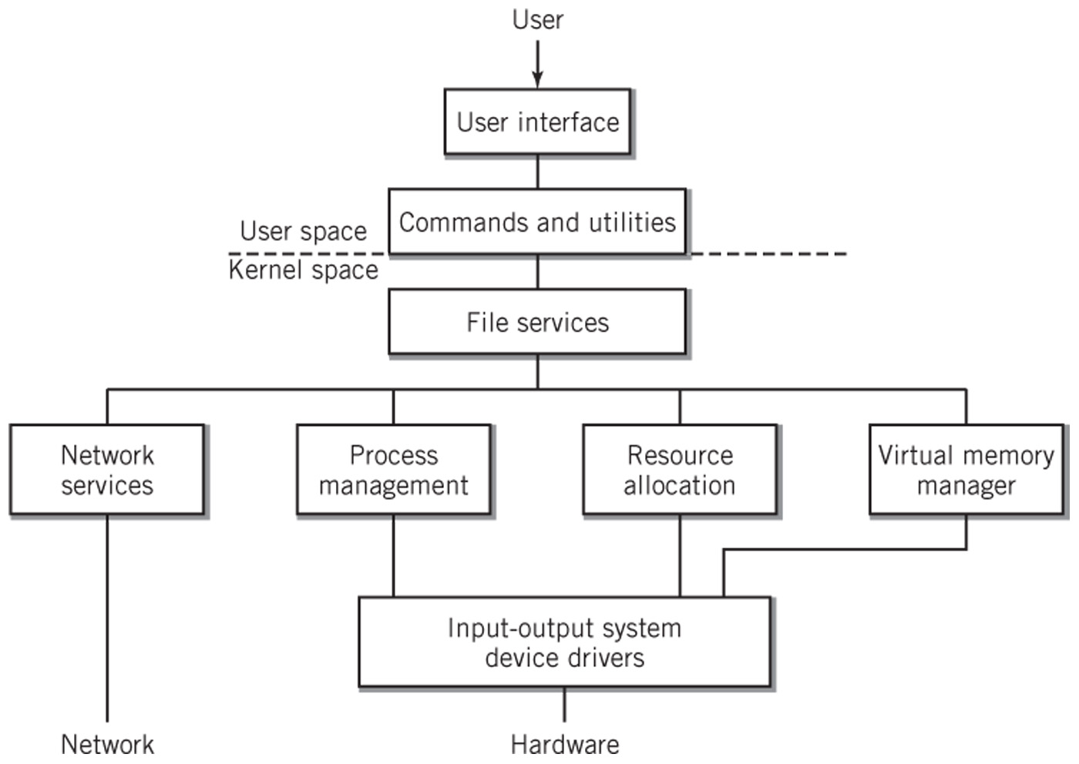
Hierarchical Model of an OS
Each layer is independent of the other layers
Requests are passed down to the layer immediately below it

Slide 34
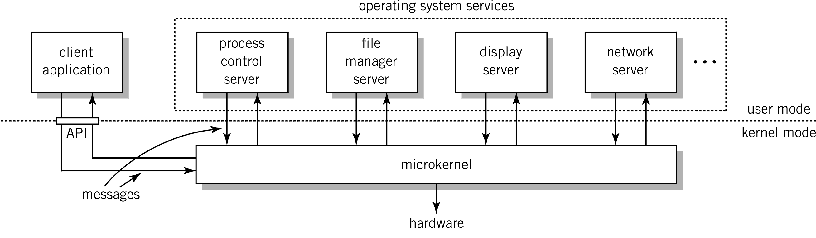
Microkernel
Minimum essential functionality
Client-server system on same system
  Clients request services from microkernel which passes message onto appropriate server

Slide 35
8 Types of Operating Systems
Single user, single tasking (obsolete)
Single-user systems and workstations
  Predominant systems in use
  Macintosh OSX, versions of Windows, Linux and Sun Solaris
Mainframe systems
  Designed to manage large scale computing resources
  Extensive I/O capability to handle large numbers of transactions
  Support batch data processing operations
  Consist of clusters made up of multiprocessor units
Network servers
  Focused on supporting clients connected to the server
  Improved security, high reliability, backup facilities

Slide 36
8 Types of Operating Systems
Mobile operating systems
  Designed for small hand-held devices such as PDAs and smart phones
  Features of single-user multitasking systems but with constraints on memory, storage, CPU execution speed and electrical power
  Special keyboard handling
Real-time systems
  One or more processes must be able to access the operating system immediately
  Multitasking system where the real-time program’s interrupts have very high priority
  Examples
    Air controller systems, rocket propulsion control systems, car brakes

Slide 37
8 Types of Operating Systems
Embedded control systems
  Specialized systems designed to control a single piece of equipment such as an automobile or a microwave oven
  Software is usually provided in ROM
  Real-time system dedicated to the particular application
  Example: General Motors Delphi system
Distributed systems
  Processing power distributed among computers in a cluster or network
  Example: Distributed Computing Environment (DCE)

Slide 38
Quick Review Questions
The definition of an operating system specifies two primary purposes served by the operating system. What are they?
Explain the major error in the following sentence: ‘‘One of the major tasks performed by the operating system program is to load and execute programs.’’
Explain concurrent processing. Briefly describe at least two services that an operating system must provide to support concurrent processing.
What are the memory resident parts of an operating system called? When are these parts loaded into memory?
What is a diskless workstation or thin client?
What does API stand for? What is the purpose of an API?
Operating systems are said to be event driven. Explain what this means.
What is the difference between multiprogramming and multiprocessing?
What tasks are performed by device drivers?

Slide 39
Summary
Modern operating systems provide an interface that is used by programs and by the user to interact with the system. The interface provides a variety of user and program services, including a user interface with command capability, program execution and control capability, I/O and file services for programs and for users, command languages for building programs of commands, system information, security features, and inter-user communication and file sharing capability. An application programming interface (API) provides a standard set of services that application programs use to access the operating system and to provide a common look and feel to their user interfaces. In this chapter we considered each of these services.

Slide 40
END
Q&A

Slide 41
Next
Operating System: User View

